Slide 1
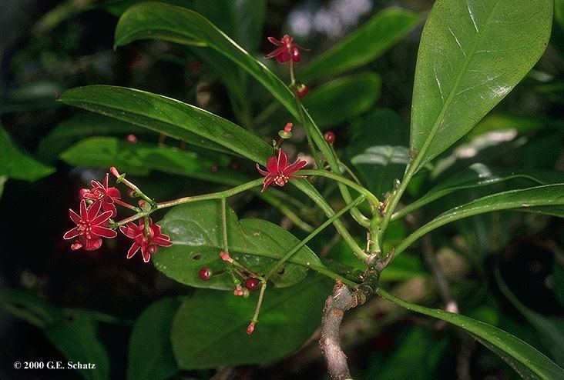
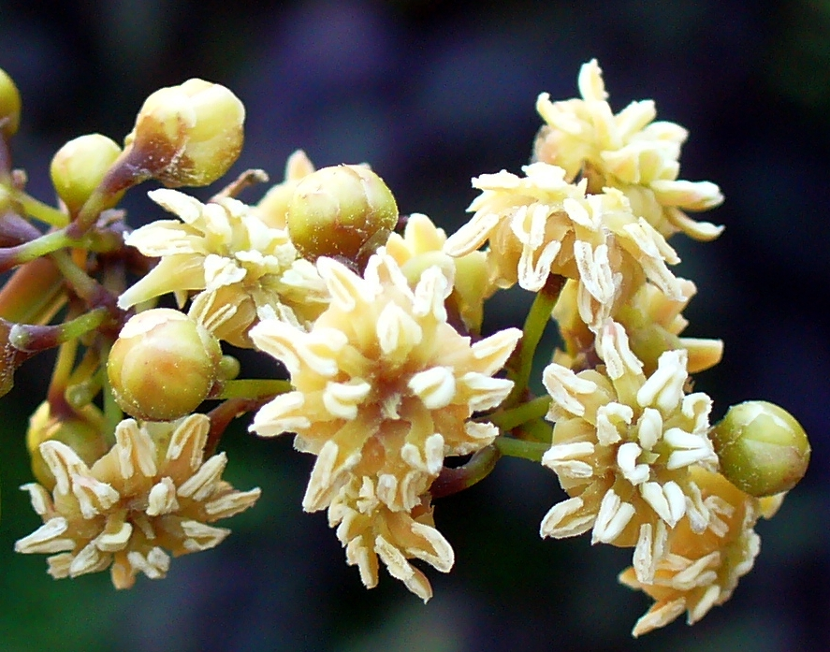
Spatial distribution of phylogenetic and trait diversity of angiosperms

Slide 2
Intro
Phylogenetic study of where on earth is the early history of angiosperms disproportionally preserved?
I.e. where communities with longer than expected branch lengths

Slide 3
Intro
How does this compare to traditional ideas about this
Classic hypotheses
Traditionally focus on tropical rainforest, island environments and old geologies
Climatically stable ancient oceanic islands
New Caledonia, Madagascar, etc.
OCBILs
Geologically old, climatically stable regions, with low fertility that allow for low extinction
South Africa, SW Australia, etc.

Slide 4
Intro
Are PD &/or species richness higher in these areas
Is the presence of plesiomorphic angiosperm traits associated with these areas?

Slide 5
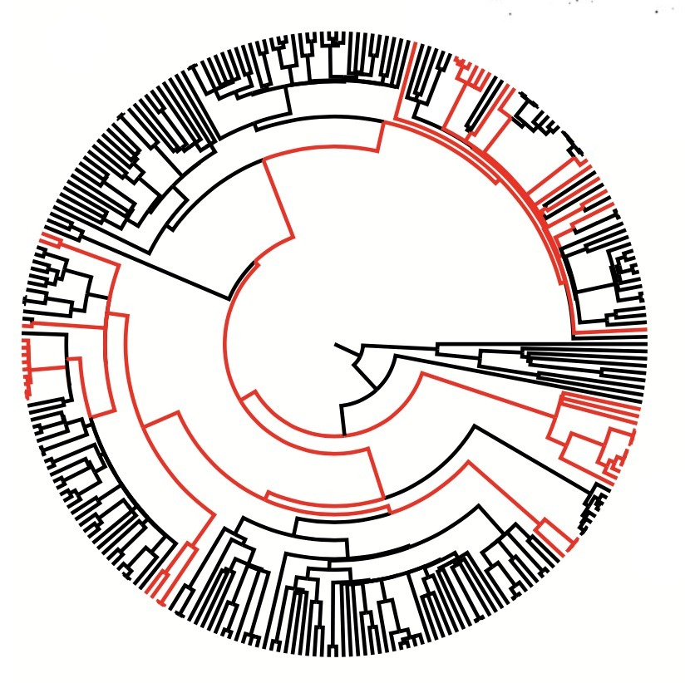
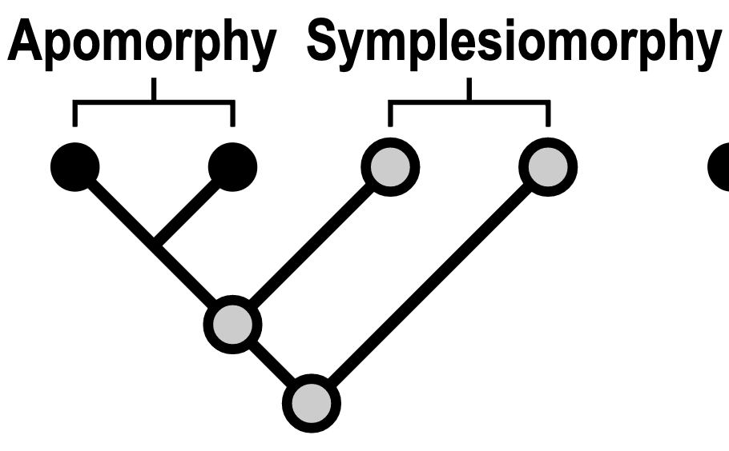
How?
First step – map where the early diversity of flowering plants is best preserved today
Two ways to measure
Phylogenetic diversity
Popular modern method
Merge spatial and phylogenetic data, calculate one of several summary stats
Trait diversity
Often what early hypotheses referred to – plesiomorphic traits
Wanted to assess in two ways – phylogenetic stats but traditionally morphologically conservative taxa were the focus

Slide 6

Biotaphy project
Collaborative project between UF, KU, U Mich, MSU
Preliminary analyses
Data wrangling – linked ~40,000 SDMs with trait data, environmental predictors

Slide 7
Definitions
Node ages
Tip and node
Tip ages

Slide 8
Traits
Made a list of 22 traits that
Are highly conserved
Able to be scored at the familial or ordinal levels
We will discuss 5: Laminar stamens, perianth phyllotaxis, stamen phyllotaxis, chloranthoid teeth, & ethereal oil cells

Slide 9
Traits
Scored traits categorically as 0, 1, 2…, etc. at familial and ordinal levels
Traits recovered as ancestral by (Soltis et al. 2018) were assigned the “0 “ category
Any other number is assigned to derived states/ apomorphies
Traits were associated to individual taxa by GBIF backbone taxonomy

Slide 10
Traits
Used these traits as a proxy for overall ancestral trait diversity
Focused on proportion of the community with plesiomorphic traits
E.g. --A grid cell with 0.5 chloranthoid teeth = half of the community members in that grid cell have chloranthoid teeth
Considered both individual traits and means

Slide 11
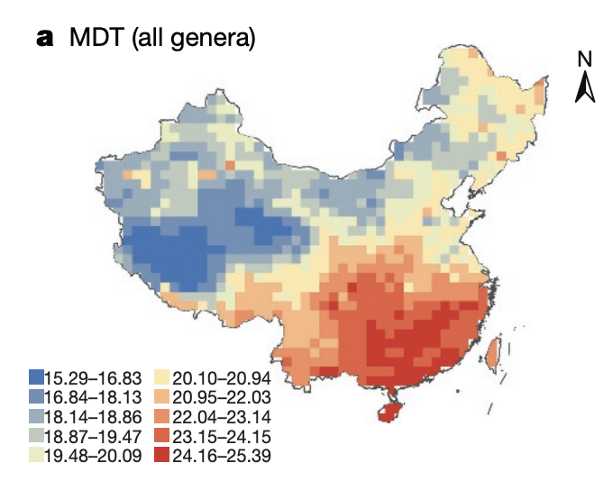
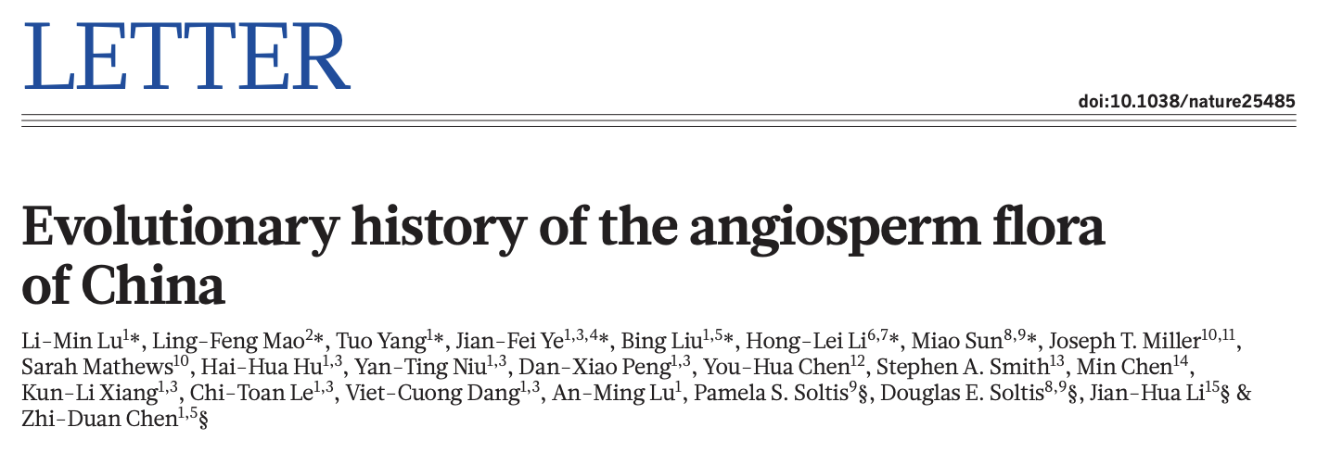
Goals
Determine global patterns of angiosperm community age
Classic hypotheses about ”relicts” in climatically stable island environments – Madagascar, New Caledonia
In many respects, expanding on a recent Nature paper on the flora of China – uncovered major age gradients related to climate stability and orogeny
Relied heavily on taxonomic ranks

Slide 12
Tip and node ages
Largely measure the same thing… R² 0.6467
Typical problem – separating species richness effects from biodiversity measures
Not cumulative like Faith’s PD but there could still be sampling effects
Node height ~ species richness R² 0.1289
Could include species richness as predictor to separate
Tip length ~ species richness R² 0.004349, continued with this
Explanatory power of environmental variables was also better for tip length (with ~0.4 more R²)
Focused on tip lengths

Slide 13
Dataset properties
Are communities with phylogenetically old species enriched for plesiomorphic traits?
Plesiomorphic traits correlate weakly or not at all to phylogenetic measures of age
E.g., ethereal oil cells vs. mean node age, R² 0.024

Slide 14
Maps of trait diversity
Showing fractional richness of plesiomorphic trait
Each grid shows species richness for only taxa with the trait
Color scale
Jenks natural breaks (scaling is long-tailed in many)
Deals with exponential and other distributions
Brings out contrast in the dataset
Scaling depends on variable (not 0% to 100%)

Slide 15
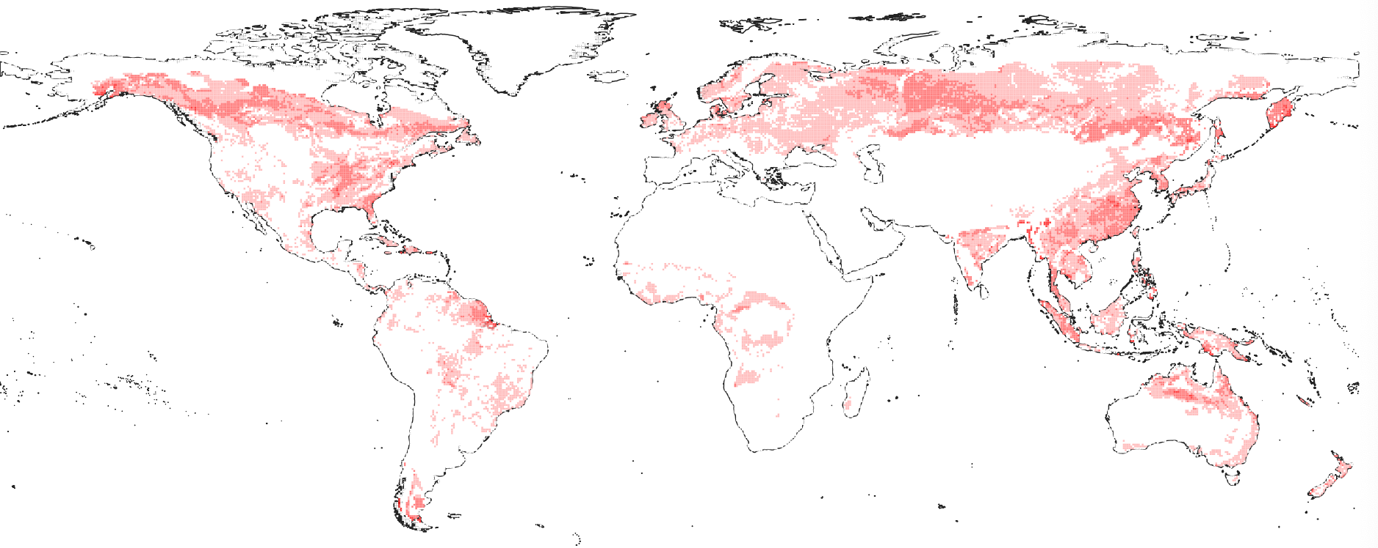
Laminar stamens

Slide 16
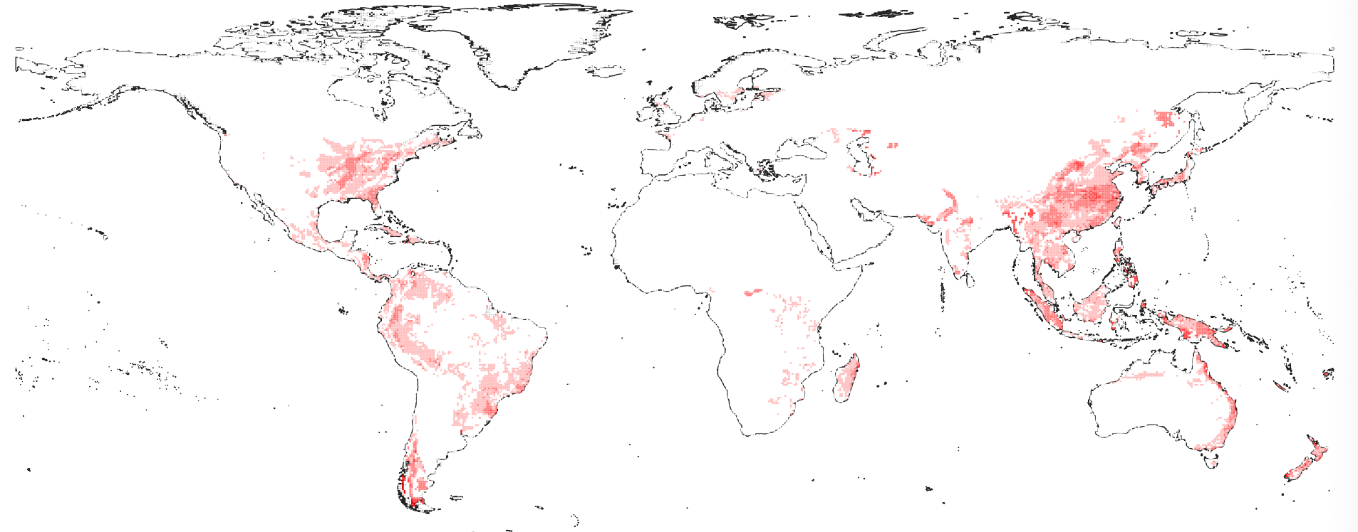
Perianth phyllotaxis

Slide 17
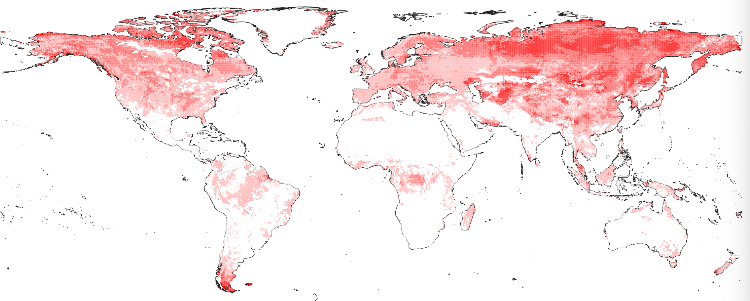
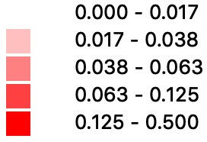
Stamen phyllotaxis

Slide 18
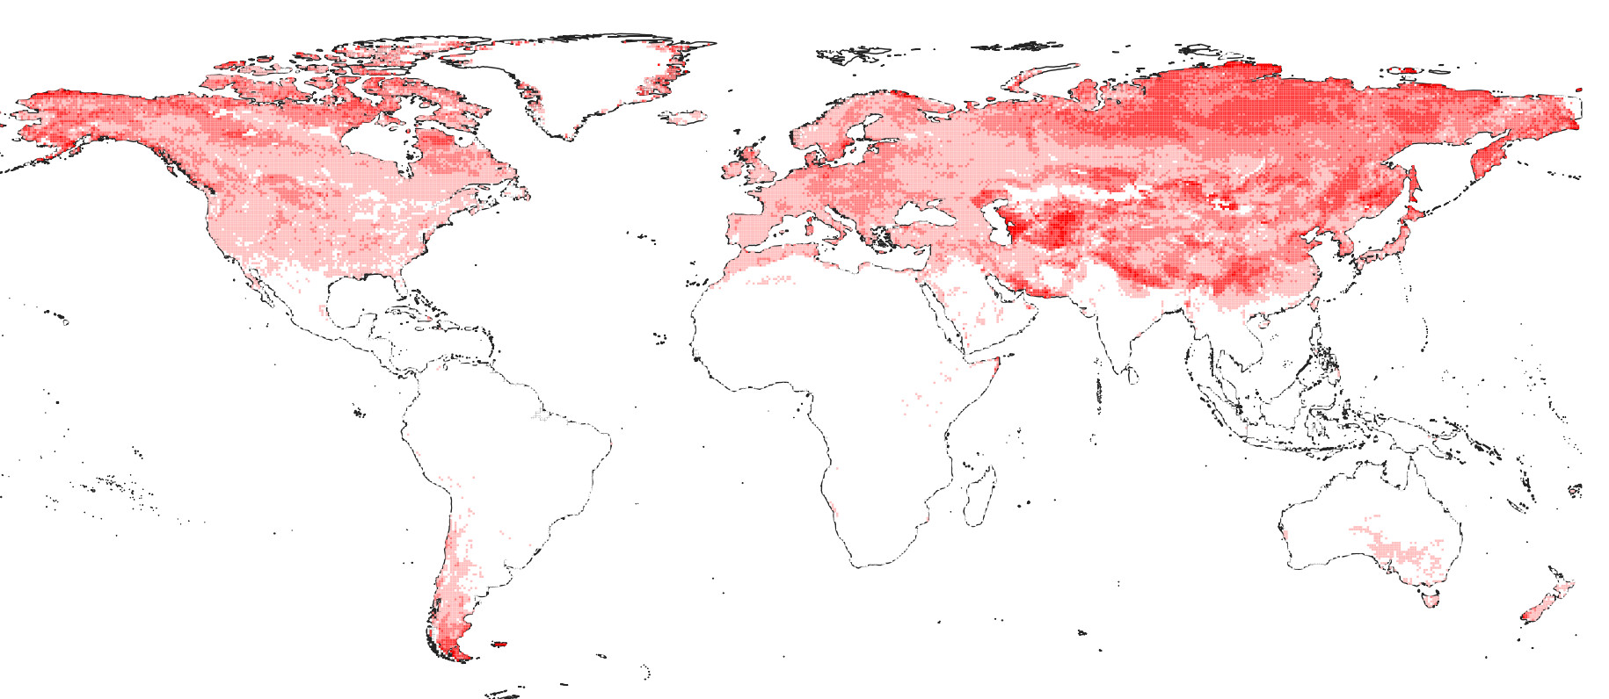
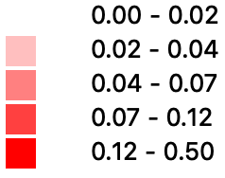
Chloranthoid teeth

Slide 19
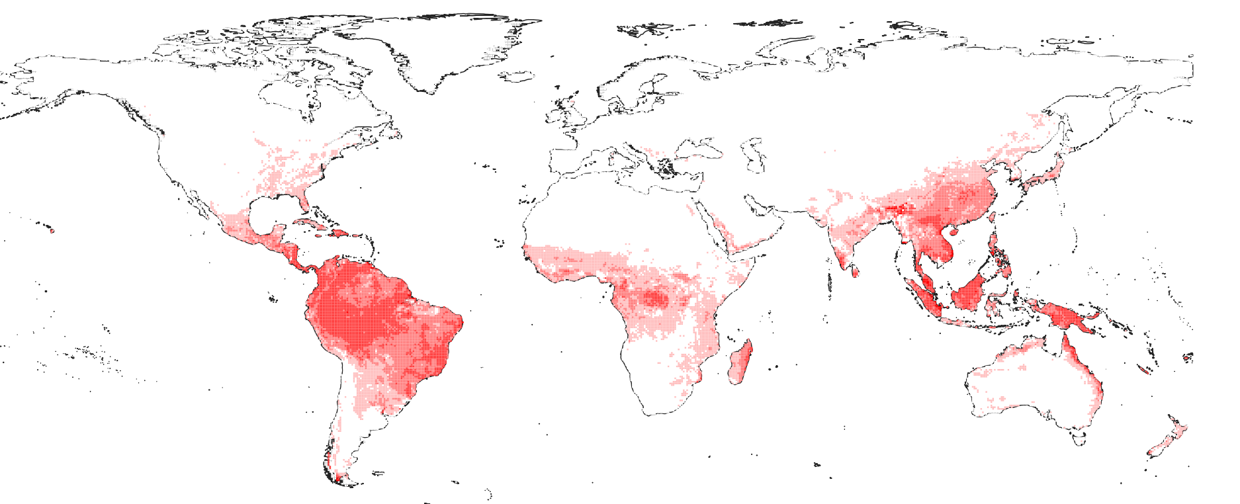
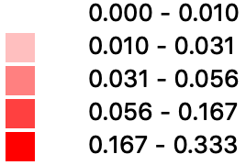
Ethereal oil cells

Slide 20
What have we learned?
Not all traits share the same distribution
We predicted we could find areas where ancestral traits were concentrated, but we found little concordance among them

Slide 21
More common pattern – reverse of expectation

Slide 23
Opposite pattern – follows expectations
Note – some traits are too rare to produce meaningful plots

Slide 24
Model fitting
Put grid cells in a model fitting framework
Generalized Linear Model
Focused on tip lengths per reasons from previous slide
Treated tip length as response variable
Seek to identify environmental drivers of community age metrics

Slide 25
Model fitting
Model of environment – 12 temperature, precipitation, soil predictors, tip length as response
Adj. R2 0.663 – good explanatory power
Normalized coefficients with intuitive interpretation
Positive correlation (associated with older species): precipitation, temperature, elevation
Negative correlation (associated with younger species): seasonality, soil fertility
Variable importance (absolute value of standardized coefficients): Mean annual temperature → mean annual precipitation → soil predictors

Slide 26
Summary of initial observations
Trait-based measures that try to capture classic hypotheses
Traits based measures
don’t agree:
Among themselves
With phylogenetic measures of species age
Have different environmental correlates

Slide 27
Next steps
Tease apart differing environmental relationships with measures of community “age” or PD
Different ways of measuring climate disturbance – investigate central hypothesis of historical climate-trait relationships but for now looks like little relationship

